Slide 1

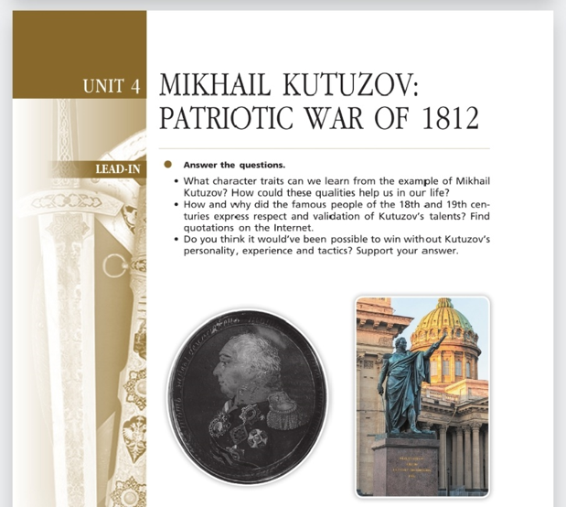
Михаил Кутузов: Отечественная война 1812 года. MIKHAIL KUTUZOV: PATRIOTIC WAR OF 1812.
Урок 4.
10 класс

Slide 2

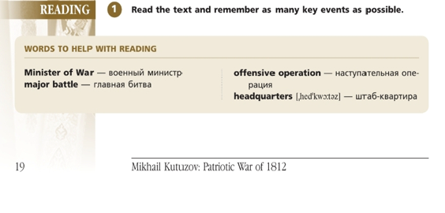
Reading.
Read the text and remember as many key events as possible.
Words to help with reading.

Slide 3
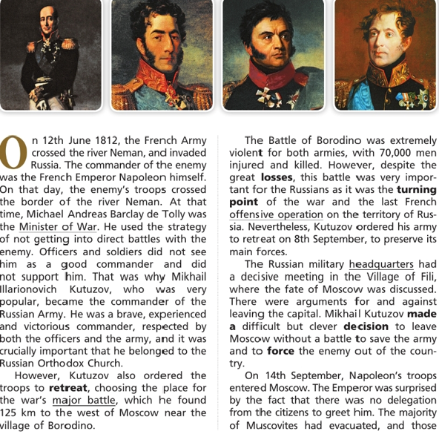
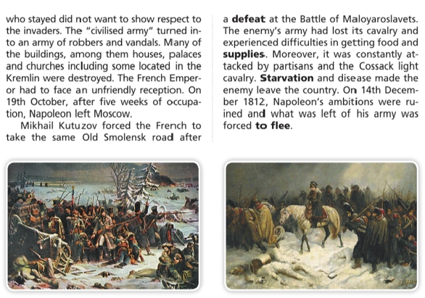

Read the text and check your answers:
4

Slide 4
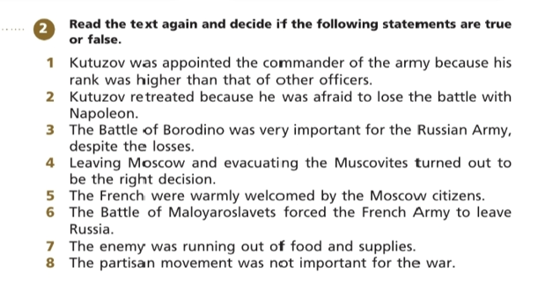
5
Поиск информации для ответов на вопросы к тексту. Задание на True/False.

Slide 5
6
Ключи к заданию 2
1. Kutuzov was appointed the commander of the army because his rank was higher than that of other officers. | False (F)
2. Kutuzov retreated because he was afraid to lose the battle with Napoleon. | False (F)
3. The Battle of Borodino was very important for the Russian Army, despite the losses. | True (T)
4. Leaving Moscow and evacuating the Muscovites turned out to be the right decision. | True (T)
5. The French were warmly welcomed by the Moscow citizens. | False (F)
6. The Battle of Maloyaroslavets forced the French Army to leave Russia. | True (T)
7. The enemy was running out of food and supplies. | True (T)
8. The partisan movement was not important for the war. | True (T)

Slide 6

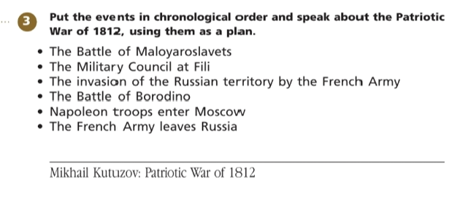
Put the events in chronological order and speak about the Patriotic War of 1812, using them as a plan.

Slide 7
Ex. 3. Put the events in the chronological order and be ready to speak about the Patriotic War of 1812, using them as a plan.
Keys:
The invasion of the Russian territory by the French Army;
The Battle of Borodino;
The Military Council at Fili;
Napoleon troops enter Moscow;
The Battle of Maloyaroslavets;
The French Army leaves Russia.
Проверьте себя
7

Slide 8
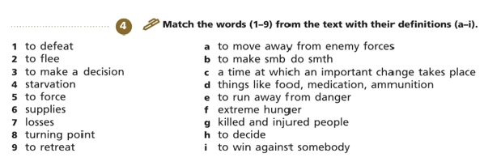
Задание № 4: Соотнесите слово с его определением.
Match the words (1-9) with their definitions (a-i).
7

Slide 9
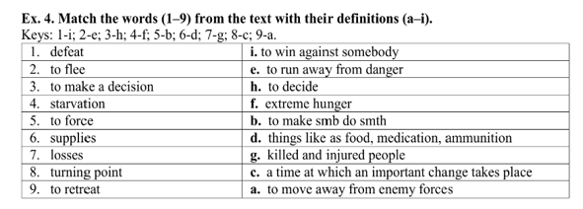
Проверьте себя

Slide 10
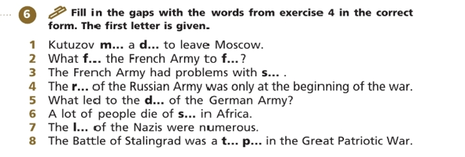
Мини-тест.
Fill in the gaps with the words from exercise 4 in the correct form.

Slide 11

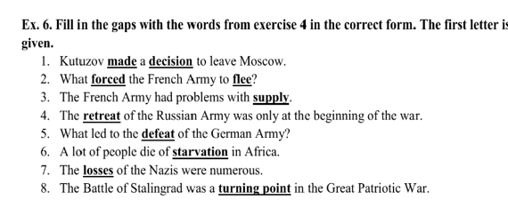
Проверьте себя
(ключи к заданию 5)

Slide 12
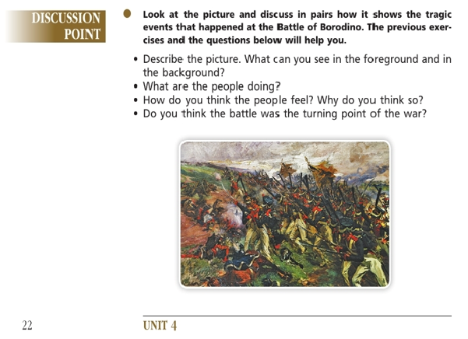
Discussion Point.

Slide 13
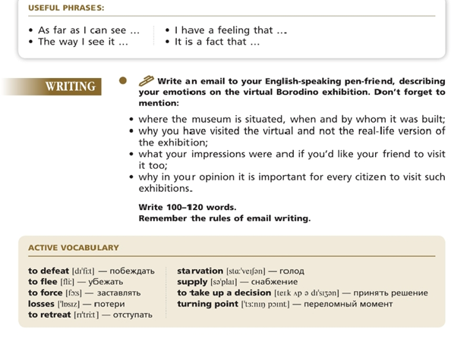
Домашнее задание:

