Slide 1

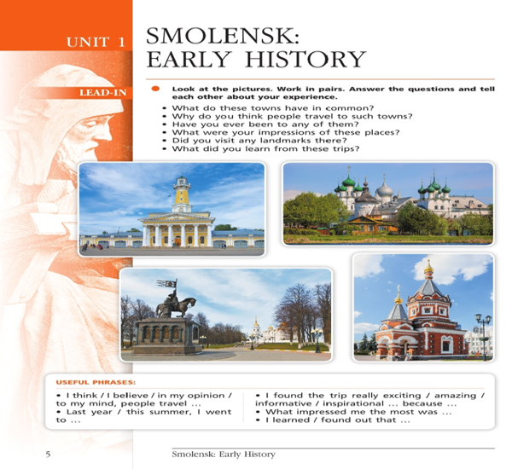
1
Смоленск. Ранняя история. Smolensk: Early History.
Урок 1.
10 класс

Slide 2

Answer the questions:
Who are the Slavs?
What Slavic tribes do you know?

Slide 3

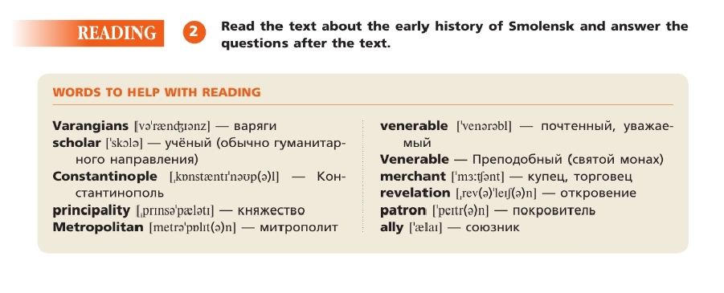
3
Words to help with reading:

Slide 4
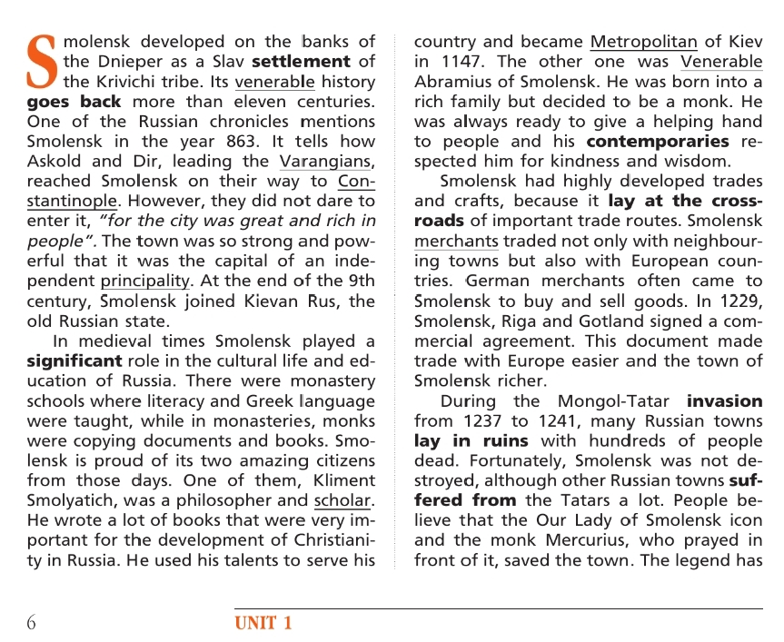
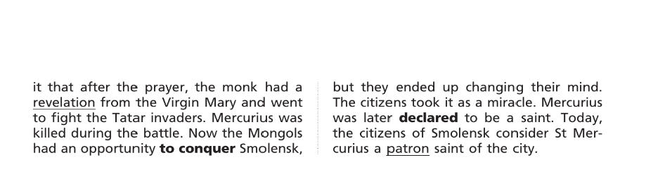

Listen and read the text about Early History of Smolensk, then answer the questions below
4

Slide 5
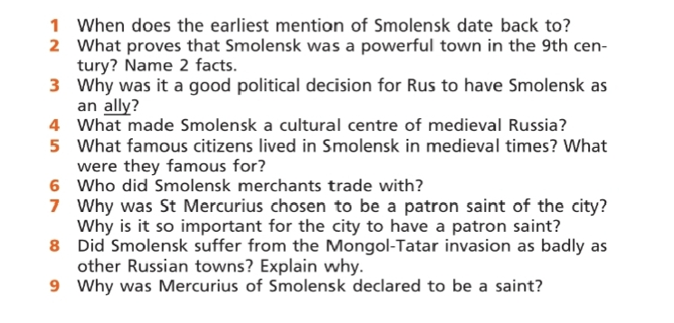
5
Answer the questions below:

Slide 6
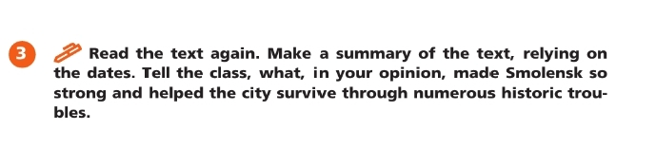
6
Монологическое высказывание, сообщение, рассуждение с изложением собственного мнения и краткой аргументацией.

Slide 7

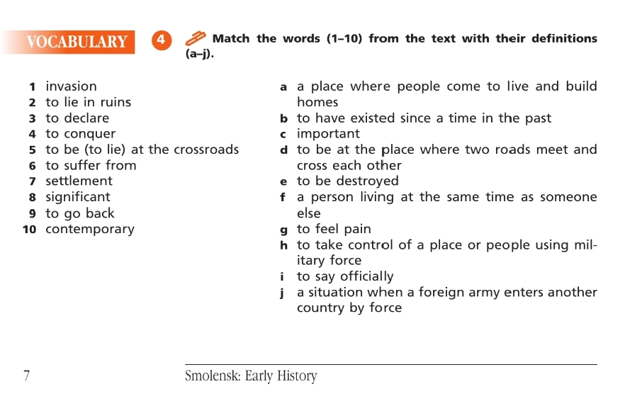
ex.4 page 7
Соотнесите слово с его определением
7

Slide 8
Проверьте себя
Keys: 1-j, 2-e, 3-i, 4-h, 5-d, 6-g, 7-a, 8-c, 9-b, 10-f.
1. Invasion - j. a situation when a foreign army enters another country by force
2. to lie in ruins - e. to be destroyed
3. to declare - i. to say officially
4. to conquer - h. to take control of (a place or people) using military force
5. to be (to lie) at the crossroads - d. to be at the place where two roads meet and cross each other
6. to suffer from - g. to feel pain
7. settlement - a. a place where people come to live and build homes
8. significant - c. important
9. to go back - b. to have existed since a time in the past
10. contemporary - f. a person living at the same time as someone else
7

Slide 9
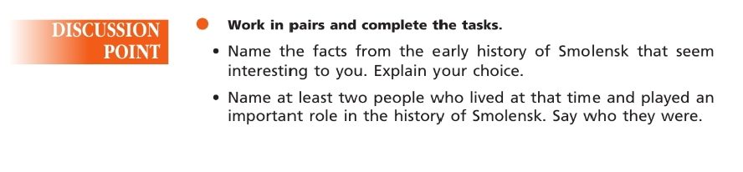
Discussion point Work in pairs
7

Slide 10
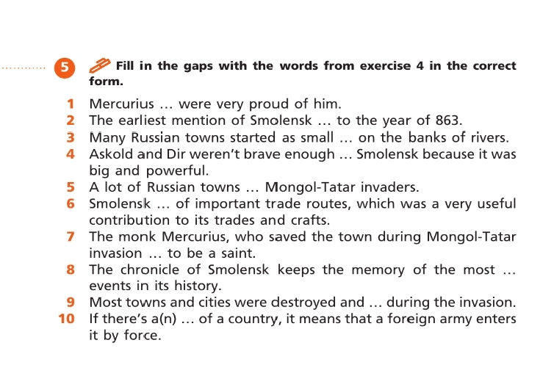
Мини-тест.
Fill in the gaps with the words from exercise 4 in the correct form.

Slide 11
9
Мини-тест.
Fill in the gaps with the words from exercise 4 in the correct form.
1. Mercurius contemporaries were very proud of him.
2. The earliest mention of Smolensk goes back to the year of 863.
3. Many Russian towns started as small settlements on the banks of rivers.
4. Askold and Dir weren’t brave enough to conquer Smolensk because it was big and powerful.
5. A lot of Russian towns suffered from Mongol-Tatar invaders.
6. Smolensk lay at the crossroads of important trade routes, which was a very useful contribution to its trades and crafts.
7. The monk Mercurius, who saved the town during Mongol-Tatar invasion was declared to be a saint.
8. The chronicle of Smolensk keeps the memory of the most significant events in its history.
9. Most towns and cities were destroyed and lay in ruins during the invasion.
10. If there’s an invasion of a country, it means that a foreign army enters it by force.

Slide 12
Задайте друг другу вопрос по теме, используя новую лексику
Составьте несколько предложений с новыми словами по теме урока

Slide 13
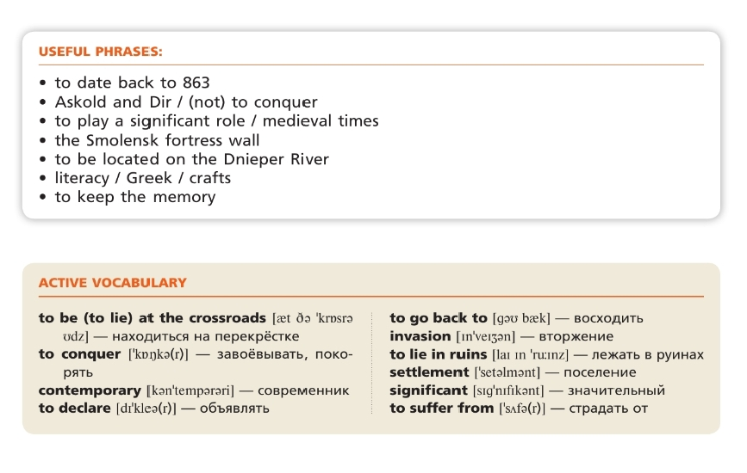
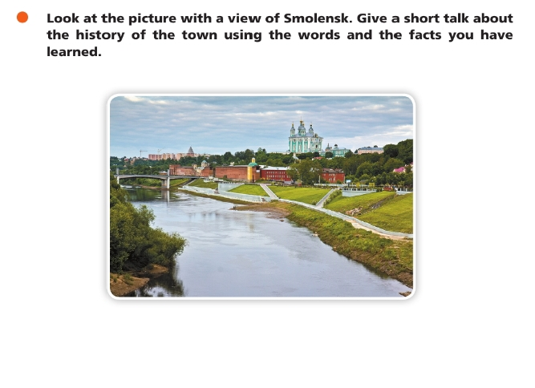
Домашнее задание:
1)выучить новые слова и полезные фразы;
2)Творческое задание: Make a short story about the History of Smolensk using the words and the facts you have learned.

