Slide 1

WEATHER

Slide 2
boiling hot
frosty
warm
rainy
snowy
cold
Weather
windy
cool
cloudy
sunny
hot

Slide 3
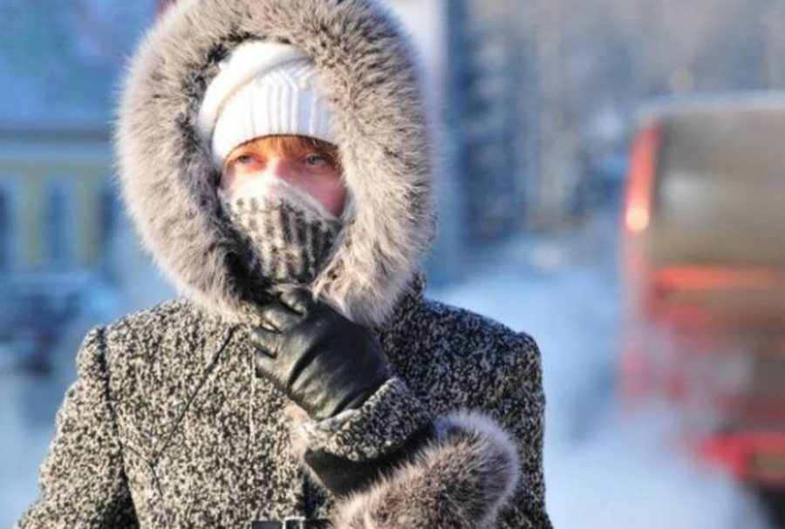
What’s the weather like today?
It’s cold today

Slide 4
Freezing cold and snow
Stormy
Boiling hot
Cloudy
Chilly and foggy
Scorching sun
Heavy rain
Huge snowstorms
Light breeze
Strong winds
Light showers

Slide 5
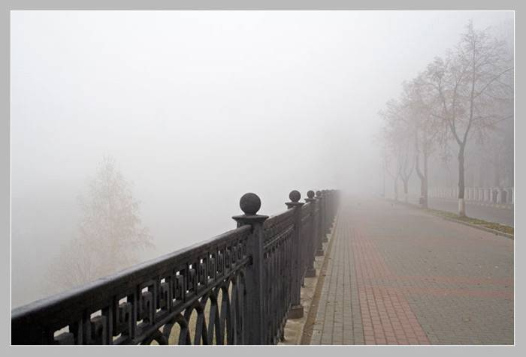
Chilly and foggy

Slide 6

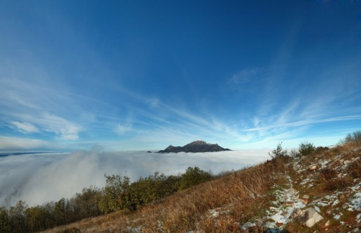
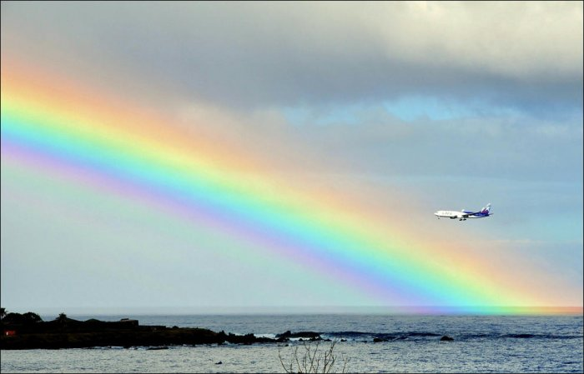


What’s your favorite weather?

Slide 7
Hi! I’m Tom Wells. The weather this week is going to be quite variable. For the first half of the week, the northwest part of the country is going to have …….. temperatures, blue skies and gentle ……………. . But as the week moves on, ………… will gather bringing some light ………………. which may turn into heavy …….. . The weather in the north, however, will be much …………. with high ……….. and a possibility of violent ………….. . During the early hours of the night expect some ………… fall. Drivers are warned to take care when driving in the morning because of the possibility of ice on the roads. Yet, there is good news for the weekend. The weather will clear up with plenty of …….. on both days.
mind
breezes
clouds
showers
rain
colder
winds
storms
snow
sun

Slide 8

Home task
Compose the dialogues and act them out on the base of Ex.9 p.81 and Ex.5 p.80
Good bye!

